Slide 1
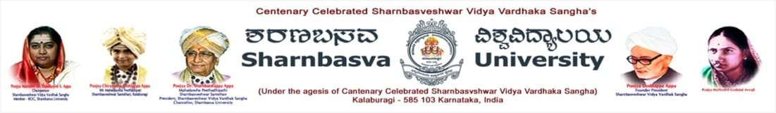


About
Contact
IMAGE SHARPENINGUSING KNOWLEDGE DISTILLATION
PRESENTED BY:
SUFIYA (SW22CSE069)
SUMAIYA SHAIKH (SW22CSE083)
SYEDA MUNZAREEN (SW22CSE107)
Mentor:
Dr.Shivleela Patil
1

Slide 2
Home
About
Contact
TABLE OF CONTENTS
1
2
3
4
5
INTRODUCTION
METHODOLOGY
IMPLEMENTATION
RESULTS AND DISCUSSION
CONCLUSION AND REFERENCE
2

Slide 3

INTRODUCTION
Home
About
Contact
Image sharpening is an essential image enhancement technique used to improve the visual clarity of images by accentuating fine details and edges. It is widely used in fields such as photography, medical imaging, remote sensing, and computer vision. The primary goal of sharpening is to make an image more visually appealing or more useful for analysis by highlighting critical features.
Traditional sharpening techniques such as unsharp masking, high-pass filtering, and Laplacian filters use fixed mathematical operations to enhance edges. However, these methods often struggle in the presence of noise or blur and tend to generalize poorly to diverse image types.
3

Slide 4
OBJECTIVES
Home
About
Contact
The main objectives of this project are:
• To study and compare traditional and deep learning-based image sharpening techniques.
• To develop a deep learning teacher model capable of producing high-quality sharpened images.
• To implement a lightweight student model trained via knowledge distillation to replicate the teacher’s sharpening capabilities.
• To design and implement the complete pipeline using Python and relevant libraries like PyTorch and OpenCV.
• To evaluate the performance of the student model using standard image quality metrics such as PSNR (Peak Signal-to-Noise Ratio), SSIM (Structural Similarity Index), and inference time.
• To create a deployable sharpening tool suitable for real-time or resource-constrained applications.
$30
$30
4

Slide 5
METHODOLOGY
Home
About
Contact
System Overview
Teacher Model: Deep CNN trained on blurry-sharp image pairs to generate high-quality outputs.
Student Model: Lightweight CNN trained via Knowledge Distillation (KD) to mimic teacher.
Distillation: Combines ground truth and teacher outputs to train the student.
Tools & Technologies
Language: Python
Frameworks: PyTorch, TensorFlow
Libraries: OpenCV, PIL, NumPy, Pandas
Visualization: Matplotlib, Seaborn
Evaluation: PSNR, SSIM, Inference Time
Data Preparation
Dataset: DIV2K, BSD500, custom images
Preprocessing: Resize, normalize, apply blur
Augmentation: Flips, rotation, cropping
$30
5

Slide 6
Teacher Model Training
Model: ResNet/U-Net
Loss: L1 or MSE
Optimizer: Adam/SGD
Output: High-quality sharpened images
Knowledge Distillation
Student Model: Compact CNN
Loss: Total = α * Content + β * Distillation
Training: Uses both teacher outputs and ground truth
Model Evaluation
Metrics: PSNR, SSIM, Inference Time
Compare: Blurred Input, Teacher, Student, Ground Truth
Deployment
Export as Python module/API
Tools: Flask, FastAPI, PyInstaller
Optimize: TorchScript/ONNX for real-time use
Workflow Summary
Load & preprocess data
Train teacher model
Design & train student via KD
Evaluate both models
Deploy student model
Home
About
Contact
6

Slide 7
IMPLEMENTATION
Home
About
Contact
Development Environment
Language: Python
Libraries: PyTorch, OpenCV, NumPy, Matplotlib
Hardware: GPU-enabled system (e.g., NVIDIA CUDA)
IDE: Jupyter Notebook / VS Code
Teacher Model Implementation
Load and preprocess dataset
Build deep CNN (e.g., ResNet/U-Net)
Train on (blurred, sharp) image pairs
Save trained weights for distillation
Student Model & Distillation
Design smaller CNN model
Implement distillation loss:
Total Loss = α * Content Loss + β * Distillation
Loss
Train student model using:
Ground truth
Teacher predictions
Fine-tune α and β for balance
Evaluation & Testing
Evaluate both models on test images
Metrics: PSNR, SSIM, Inference Time
Visual comparisons of outputs
Deployment
Convert student model using TorchScript or ONNX
Build GUI/API with Flask or FastAPI
Package for real-time image sharpening
$30
$30
7

Slide 8
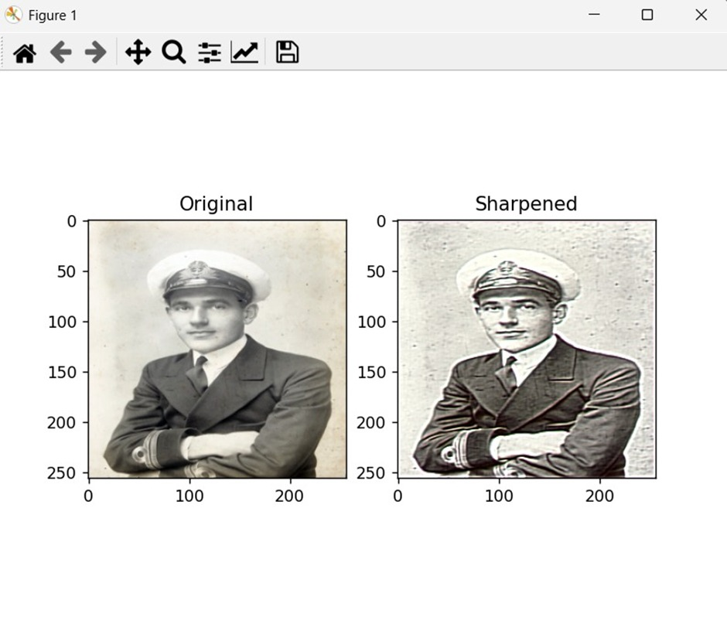
Image sharpened
RESULTS
Home
About
Contact
8

Slide 9
CONCLUSION
Home
About
Contact
This project successfully demonstrates how knowledge distillation can be used to train a compact neural network for image sharpening, effectively mimicking a teacher model's behavior using Python and PyTorch. The student model provides a fast, lightweight, and visually effective sharpening solution that can be easily deployed to real-world applications with limited computational resources.
9

Slide 10
REFERENCES
Home
About
Contact
https://docs.pytorch.org/tutorials/beginner/data_loading_tutorial.html
https://arxiv.org/abs/1503.02531
https://pytorch.org/docs/stable/optim.html
https://matplotlib.org/stable/users/index.html
10

Slide 11
Home
About
Contact
THANK YOU
11

